Slide 1
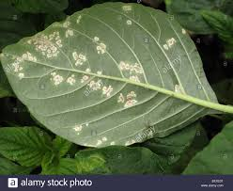
LIFE CYCLE OF ALBUGO
Prepared by,
Dr. Vijaykumar I.Rane,
Head Department of Botany,
Jagat Arts, Commerce & I.H.P. Science College, Goregaon Dist-Gondia

Slide 2
Classification
(Alexopoulos and Mims,1979)
Kingdom: Mycetae
Division: Mastigomycota
Subdivision: Diplomastigomycotina
Class: Oomycetes
Order: Perenosporales
Family: Albuginaceae
Genus: Albugo
Species: Albugo candida

Slide 3
Occurance of Albugo
Albugo (means white in Latin), the only genus of family Albuginaceae is represented by more than 30 species. It is an obligate parasite (survive only on host plant) distributed all over the world.
This genus is represented by 30 species distributed all around the world
They are all obligate parasite.
Albugo candida also known as Cystopus candidus is the most important pathogen of Brassicaceae (Crucifereae) and Amaranthaceae members, causing ‘white rust’ disease.
Other families that are prone to attack of this fungi are
Asteraceae, Convolvulaceae and Chenopodiaceae

Slide 4
Signs and Symptoms
  This pathogen attack all the above ground parts.
  The infection occurs through stomata.
  The disease results in the formation of shiny white, irregular pustules on lower surface of leaves but at later stages, the symptoms appear on both the surface.
Irregular patches also found on stems and floral parts.
In the later stages, these patches turn powdery.
The flowers and fruits get deformed.
Hypertrophy (increase in size of the cells and organs) is also a symptom of the disease

Slide 5
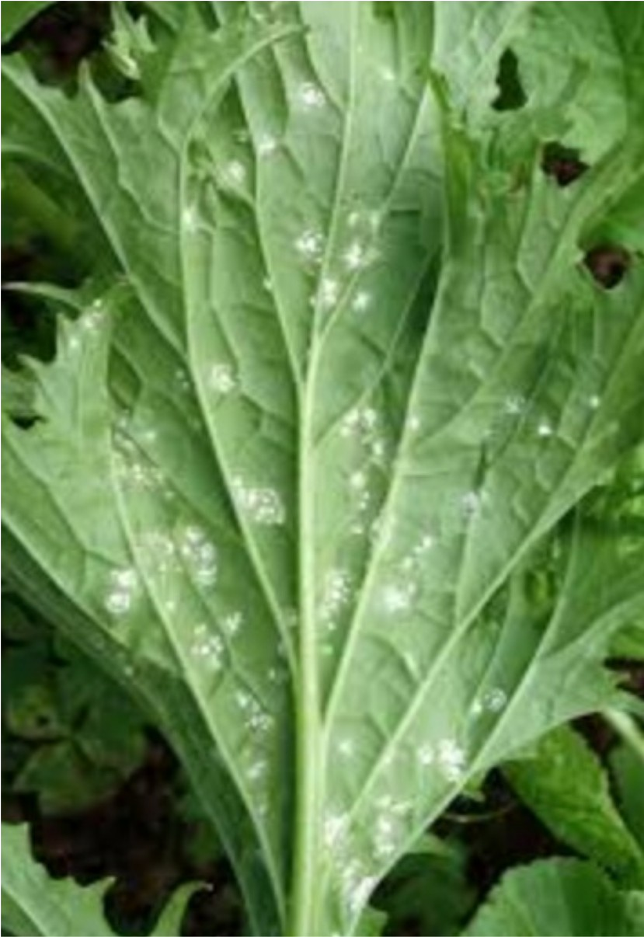

Slide 6

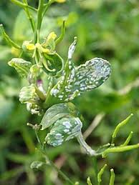

Slide 7
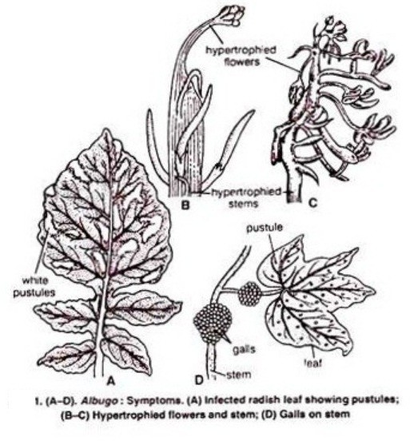

Slide 8
Structure of Mycelium
The mycelium is branched, intercellular and coenocytic (non-septate). Hyphal wall consist of fungal cellulose or chitin. Many nuclei remain scattered throughout the mycellium. The mycelium contain the many vacuoles, oil globules and glycogen. The terminal ends of lateral branches of growing intercellular mycellium penetrate the host cells. After penetration, terminal ends of hyphae swells and develop many knobs like structures in the host cells called haustoria.

Slide 9
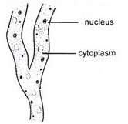
Mycelium

Slide 10
Structure and function of Haustoria
The haustoria are spherical or flattened structure. Each haustorium consist of two parts namely-(i) haustrotial head and (ii) slender neck-like stalk. The fungal cell wall is discountinued in the distal region of the stalk of the haustorium.
Haustoria helps in absorption of ready made organic food material from living host cells and supply to other adjacent intercellular mycelia.

Slide 11
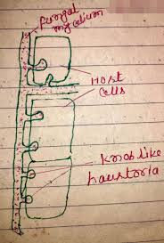
Haustoria

Slide 12
Reproduction in Albugo
The fungus reproduces both by asexual and sexual methods.
Asexual Reproduction:
  The asexual reproduction takes place by conidia, condiosporangia or zoosporangia.
  These are produced on the sporangiophores.
  Under suitable conditions the mycelium grows and branches rapidly. After attaining a certain age of maturity, it produces a dense mat like growth.

Slide 13
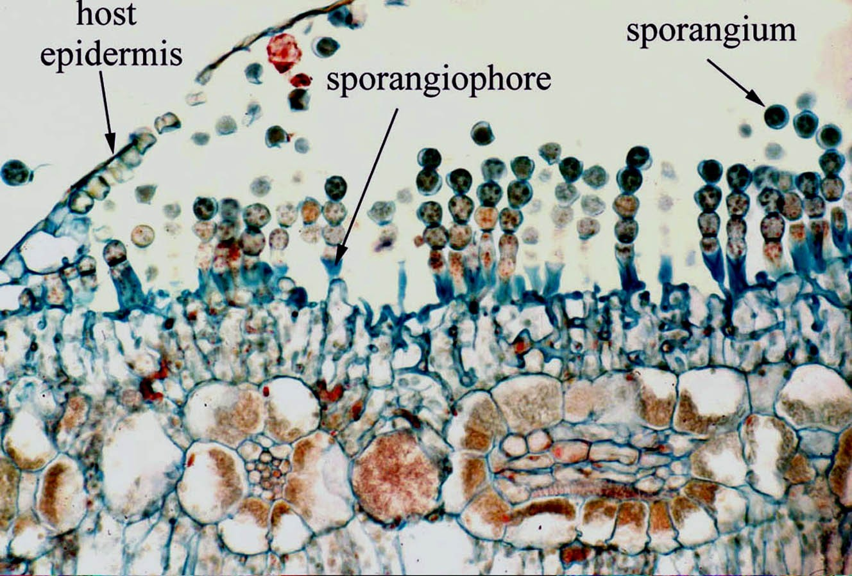
Cross-section of a leaf with condia of Albugo candida.

Slide 14
Formation of Sporangiophore
In the mat like growth, just beneath the epidermis of the host and some of the hyphae start behaving as sporangiophores or conidiophores.

Slide 15
Formation of Sporangia
A second sporangium is similarly formed from the tip just beneath the previous one. Similarly, a chain of sporangia or conidia in basipetal succession (youngest at the base and oldest at the tip) is formed above each sporangiophore.
These sporangiophores contain dense cytoplasm and about a dozen nuclei. Later, the apical portion of sporangiophore gets swollen and a constriction appears below the swollen end and results in the formation of first sporangium.

Slide 16
Formation of Sporangia…….
  After maturity, the sporangia are set free due to dissolution of separation disc (mucilagenous pad) called as disjuncture.
  Under suitable environmental conditions when they are blown away by wind or by rain water and falling on a suitable host, sporangia germinates within 2 or 3 hours. They liberates in the form of white powder, hence fungus is called ‘white rust.’

Slide 17
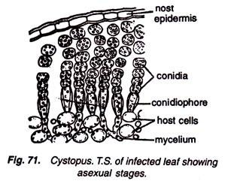
T. S. of Infected leaf showing asexual stage of reproduction

Slide 18
Structure of Sporangia
The sporangia are smooth , colorless and double walled. They are unicellular and multinucleate. Each sporangium is thick and generally globose or rounded in shape.

Slide 19
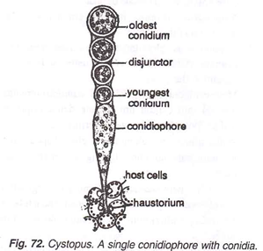
A single Conidiophore with chain of Conidia

Slide 20
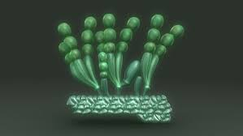

Slide 21
Germination of Sporangia
Initially the sporangia get separated by drying of mucilagenous disc (disjunctor). The sporangia are blown by wind or washed away by rain water. When they falls on suitable host, they start germinating under moist condition and low temperature. Each sporangium behave as zoosporangium. It absorb water and swells. Its multinucleate protoplast undergoes cleavage, soon it divides to form 4-12 uninucleate daughter protoplasts. Each daughter protoplast develops into biflagellate zoospore.

Slide 22
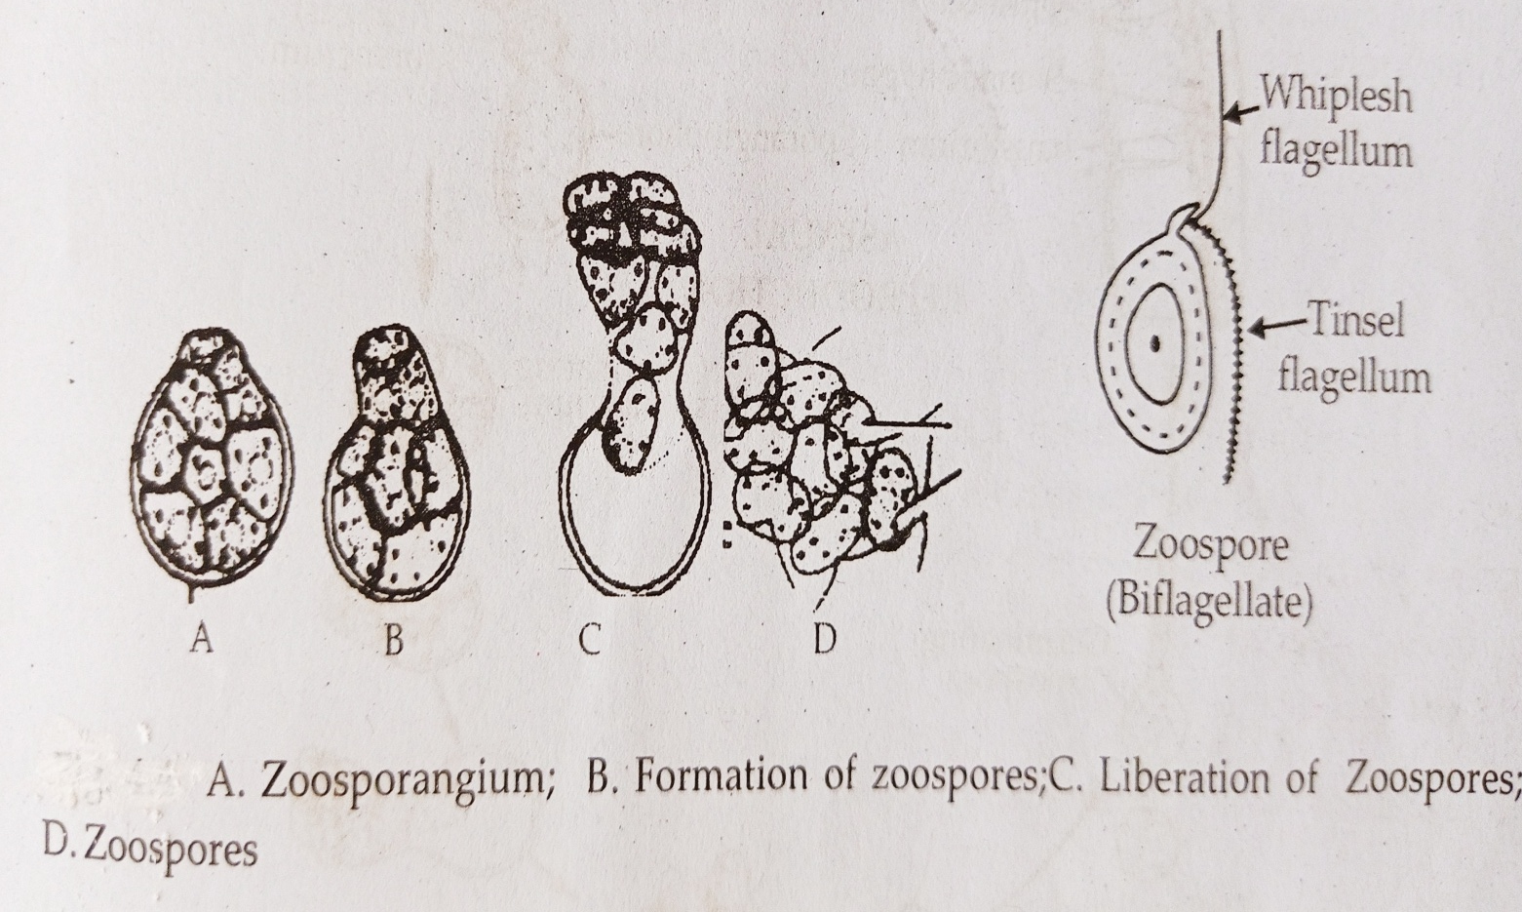
Development and structure of Zoospore

Slide 23
Liberation of Zoospore
The inner membrane of zoosporangium develops a papilla which enlarges into a vesicle. The zoospore first liberate into vesicle. The vesicle is thin, it soon dissolves so that zoospores get released in a film of water. They swim in water with the help of flagella.

Slide 24
Structure of Zoospore
Each Zoospore is unicellular, uninucleate and kidney shaped. It is protected by single layered wall. It is biflagellate. One flagellum is short , hairy tinsel type while other is long, smooth whiplash type.

Slide 25
Germination of Zoospore
On reaching on suitable host, the zoospore withdraw their flagella and get encysted. They germinate by producing germ tube under the influence of high humidity. The germ tube penetrate in to host tissue through stomata and it grows rapidly in to new mycellium.

Slide 26
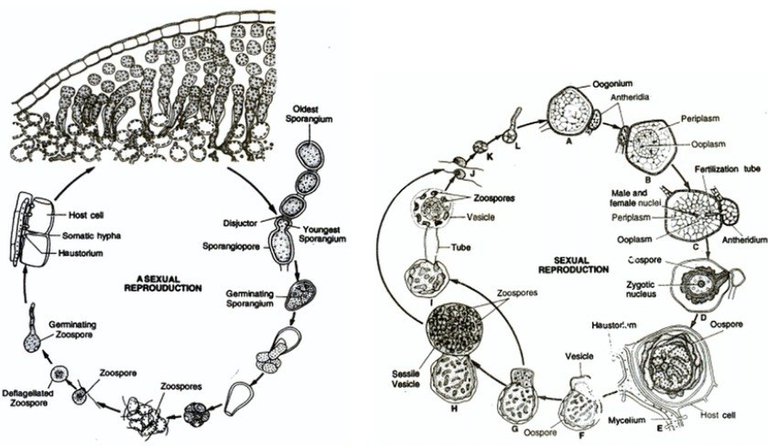
Asexual Reproduction in Albugo (Graphic life cycle)

Slide 27
Sexual Reproduction
  It takes place when the growing season comes to an end. The mycelium penetrates into the deeper tissues of the host.
  The sexual reproduction is oogamous type.
  The male sex organ is called antheridium and oogonium represent the female sex organ

Slide 28
Male sex organs (Antheridia)
It is elongated, club shaped and multinucleate structure. In some cases, only one nuclei remain functional but in some, many can remain functional. All the nuclei are haploid. Many nuclei with cytoplasm migrate to club shaped body. Then it cut off by formation of transverse septum. Each antheridium develops at terminal end of male hyphae which lies close to oogonium.

Slide 29
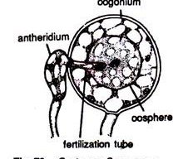
Sex Organs in Albugo candida

Slide 30
Female sex organs (Oogonia)
The terminal end of female hyphae swells and become globose in shape as oogonia. Many nuclei with cytoplasm migrate to globose body. It cut off from rest of the hyphae by formation of transverse septum. It is spherical and multinucleate containing as many as 65 to 115 nuclei. All nuclei are evenly distributed throughout the cytoplasm. As the oogonium reaches towards the maturity the contents of the oogonium get organised into an outer peripheral region of periplasm and the inner dense central region of ooplasm or oosphere or the egg. However, at the time of maturity, all nuclei disintegrate, except single functional nucleus.

Slide 31
Fertilization
Before fertilization a deeply staining mass of cytoplasm appears in the center of the ooplasm. This is called coenocentrum. The functional female nucleus attracted towards it and becomes attached to a point near it. The oogonium develops a papilla like out grow that the point of contact with the antheridium. This is called as receptive papilla, soon it disappears, and the antheridium develops a fertilization tube.
It penetrates through receptive papilla, oogonial wall and periplasm and finally reaches upto the ooplasm. It carries a single male nucleus. The tip ruptures to discharge the male nucleus near the female nucleus. Ultimately the male nucleus fuses with the female nucleus (karyogamy). Thus fertilization results to the formation of zygote or oospore.

Slide 32
Structure of Zygote
The oosphere along with the fusion nucleus is called zygote or oospore. The oospore on maturity secretes a two to three layered wall. The outer layer is thick, warty or tuberculated and represents the exospore. The inner layer is thin and called the endospore. It contain diploid nucleus with dense cytoplasm.

Slide 33
Germination of Zygote
With the secretion of the wall, the zygotic nucleus divides repeatedly to form about 32 nuclei. The first division is meiotic. At this stage the oospores undergoes a long period of rest until unfavorable conditions are over. Mean while its host tissues disintegrate leaving the oospore free. 32 nuclei divides further in 100 nuclei. Each nucleus surrounds a small cytoplasm and differentiated into biflagillated zoospore.

Slide 34
Structure of Zoospore
Each Zoospore is unicellular, uninucleate and kidney shaped. It is protected by single layered wall. It is biflagellate. One flagellum is short , hairy tinsel type while other is long, smooth whiplash type.

Slide 35
Structure of Zoospores

Slide 36
Liberation of Zoospores
The exospore is ruptured and the endospore comes out as a thin vesicle. The zoospores move out into the thin vesicle which soon perishes to liberate the zoospores. The zoospores after swimming for sometime encyst and germinate by a germ tube which again infects the host plant.

Slide 37
Germination of Zoospore
On reaching on suitable host, the zoospore withdraw their flagella and get encysted. They germinate by producing germ tube. The germ tube penetrate in to host tissue through stomata and it grows rapidly in to new mycellium.

Slide 38
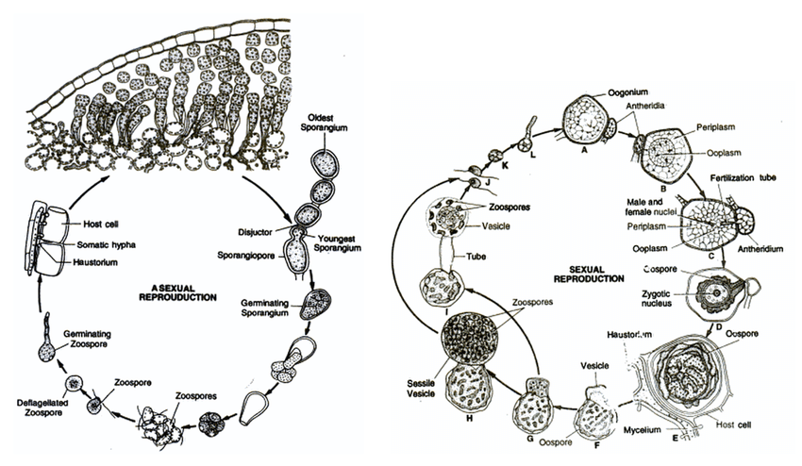
Sexual Reproduction in Albugo (Graphic life cycle)

Slide 39
THANKS TO ALL…..

